Slide 1
Tourism Management System
Designed by
VALIT

Slide 2
Team Members
Hussnain ul Abidin 22i-1102
Hamdan Sajid 22i-0872
Muhammad Sohaib 22-0879

Slide 3

Project Title

Slide 4
Technologies Used
Java for Backend
JavaFX for Frontend
MSQL for Database
CSS for Designing of frontend

Slide 5
Use Cases
Admin
Manage Tour
Manage Transport Providers
Respond to Queries
View Stats
Cancel Bookings
View Available Tours

Slide 6
Use Cases
Tourist
Register
View Tours
Book a Tour
Obtain Customer Support
Cancel Booking
Give Rating
View Booking
Request Custom Tour

Slide 7
Purpose
Tourism activity booking platform.
Booking and management functionalities.
Scalability and usability focus.

Slide 8
Problem Statement
Lack of system cohesion.
Inefficient manual processes.
Unified, integrated platform.
Enhanced user experience.

Slide 9
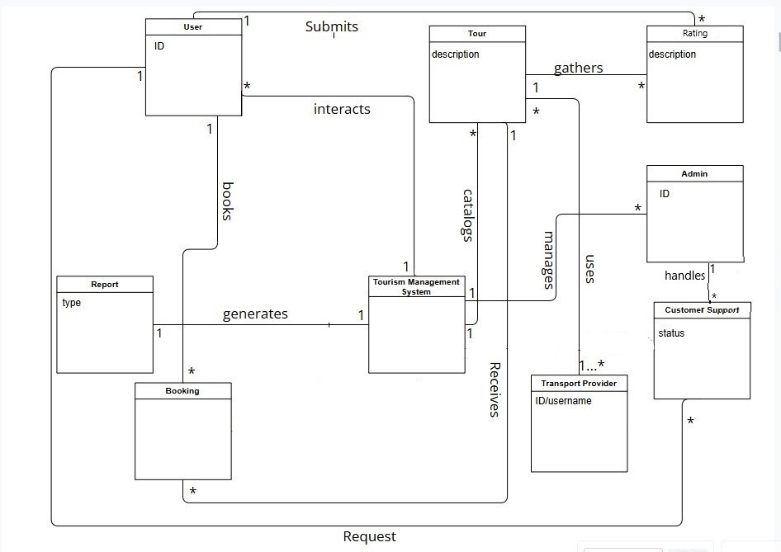
Domain Model

